Slide 1


Escape From Tarkov: Data Search
By Samuel Kashiwase and Dale Alabastro

Slide 2
What’s the system about?
An informative program for Escape From Tarkov
User chooses specific option from given list:
AR, AK, generic rifle, generic pistol, grenade
From there, user choose info display:
Damage vs Body
Penetration vs Armor
Durability vs Firearm
Price
Vendor (if sold)
etc
User can repeat program if needed

Slide 3
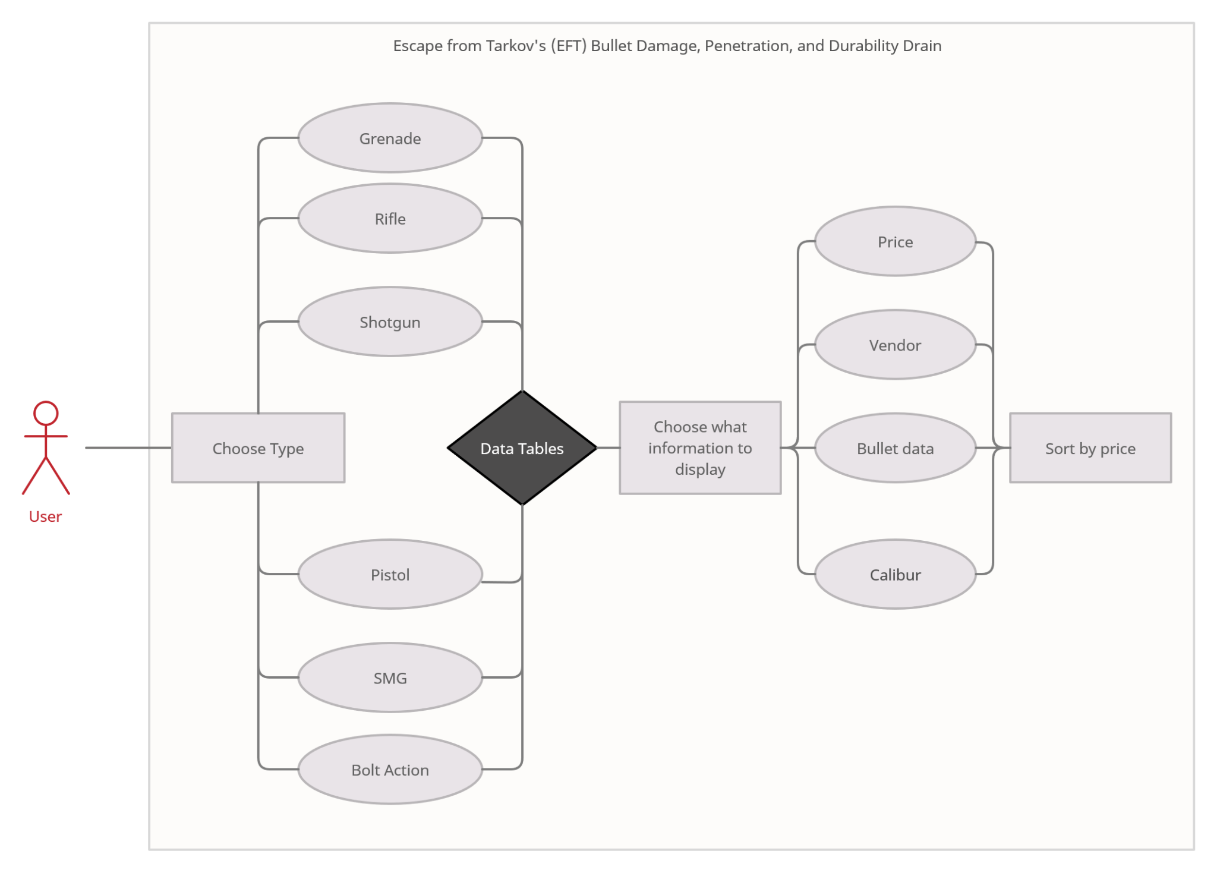
Use case diagram

Slide 4
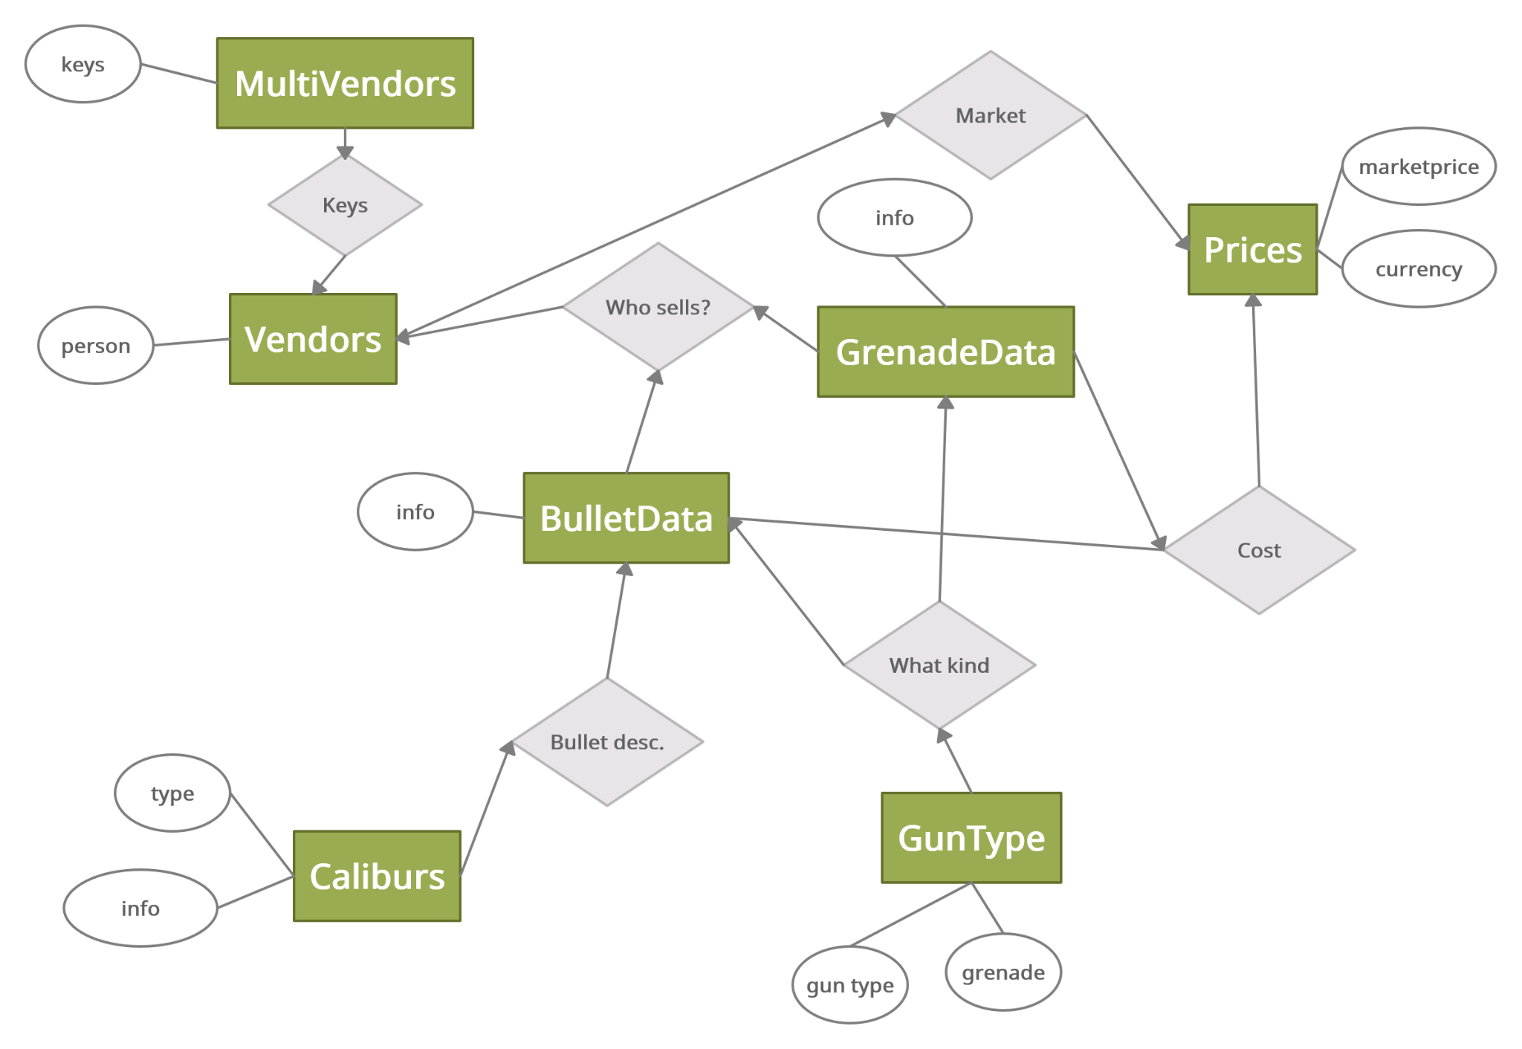
E/R Diagram

Slide 5
Relational Schema
-GunType
-t_gunCalibur
-t_gunName
-t_fireMode
-t_RoF
-t_gunType
-Caliburs
-c_gunType
-c_caliburKey
-c_calName
-BulletData
-b_caliburKey
-b_name
-b_dmg
-b_penPwr
-b_armorDmg
-b_accMod
-b_recMod
-b_fragChance
-b_riccChn
-b_lBld
-b_hBld
-b_velocity
-b_special
-b_vendorKey
-GrenadeData
-g_priceKey
-g_typeKey
-g_expDelay
-g_fragCount
-g_fragDmg
-g_radius
-Prices
-p_vendorKey
-p_calName
-p_currency
-p_price
-Vendors
-v_vendorKey
-v_vendorName
-MultiVendors
-mv_calKey
-mv_vendorKey

Slide 6
Implementation
IDE
VisualCode Studio
Database
SQLite3
User Interface
Command lines

Slide 7
Git hub:
https://github.com/dalealabastro/CSE111_E.F.T_DATABASE
-Multiple branches
-UI-Working branch is the correct one

